Slide 1
Sleep Disorder Prediction
Navya Sai Arcot
navyasai1401@gmail.com

Slide 2
Agenda
Project objective
Classifying None, Sleep Apnea, Insomnia
Understanding Dataset and features
Type of ML problem
Models Used
Target Variable
Evaluation Metrics
Exploratory Data Analysis
Model Training and Evaluation. Comparison.
Deployment
Dashboard with PowerBI

Slide 3
Project Objective
Predicting Sleep Disorders: A Data-Driven Approach
This project centers on leveraging machine learning to enhance the detection and understanding of sleep disorders, focusing on three categories: None, Insomnia, and Sleep Apnea. Our aim is to empower healthcare providers to implement early interventions, optimize patient care, and advance public awareness of sleep health.
Objectives:
Automated Prediction: Build a robust machine learning model to accurately predict the presence and type of sleep disorders.
Insightful Analysis: Uncover relationships between lifestyle, medical factors, and sleep disorders to inform prevention strategies.
Optimized Data Handling: Implement effective data preprocessing to handle complex features and ensure model reliability.
Comparative Evaluation: Assess the performance of multiple machine learning algorithms to identify the best-fit solution for this task.
By using these predictive tools and data visualizations, this project seeks to enable healthcare providers to better understand sleep patterns and create more personalized treatment plans.

Slide 4
Classifying None, Sleep Apnea, Insomnia
Improving Health Outcomes: Sleep disorders are linked to numerous health issues, including cardiovascular diseases, diabetes, mental health problems, and reduced cognitive function. Early prediction allows timely intervention, preventing complications and improving overall well-being.
Enhancing Quality of Life: By identifying sleep disorders early, individuals can receive personalized care to address their specific challenges. This leads to better sleep quality, improved daily productivity, and a positive impact on mental and emotional health.

Slide 5
Understanding Data Set and Features
The dataset contains information on individuals, including demographics, lifestyle habits, and medical metrics, to predict sleep disorders. Key features include:
Demographics: Age, gender, and occupation.
Lifestyle Factors: Sleep duration, quality of sleep, physical activity level, and stress level.
Medical Metrics: BMI category, blood pressure, and heart rate.
Daily Activity: Number of daily steps.
The target variable is Sleep_disorder, categorized into None, Insomnia, or Sleep Apnea. This dataset enables the identification of patterns influencing sleep health and facilitates the development of predictive models.

Slide 6
Type of ML problem
As we can see the target feature ‘Sleep Disorder’, We are dealing with Multi-class Classification problem.

Slide 7
Models Used
Decision Tree
Random Forest
K-Nearest Neighbors (KNN)
Support Vector Machines (SVM)
Gradient Boosting
AdaBoost
XGBoost

Slide 8
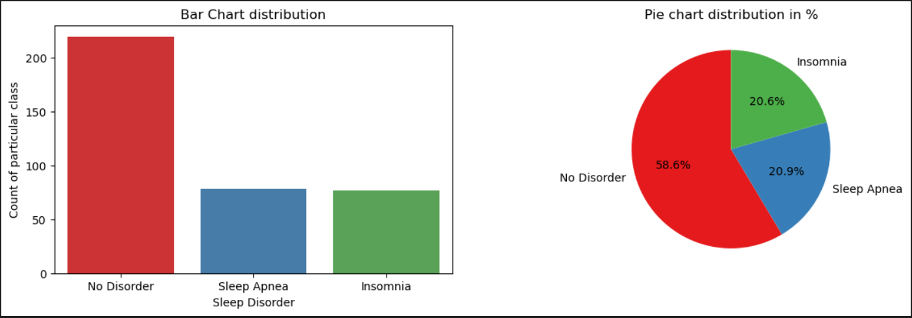
Target variable
We are dealing with imbalance dataset.

Slide 9
Evaluation Metrics
For classification, we used metrics like
Accuracy
Recall
Precision
F1 Score
Confusion Matrics and
Classification report
But Accuracy does not account the class imbalance.

Slide 10
Exploratory Data Analysis
Understanding the data
Handling the Missing Values
Outlier Analysis
Univariate Analysis
Bivariate Analysis
Standardizing all values to one scale(min-max Scaler)
Label Encoding

Slide 11
Missing Values
There were no missing values in all the independent variables or features but nearly 151 missing values in Target (Sleep Disorder)
They were “None” which actually means there is no disorder, have changed it has “No disorder”.

Slide 12
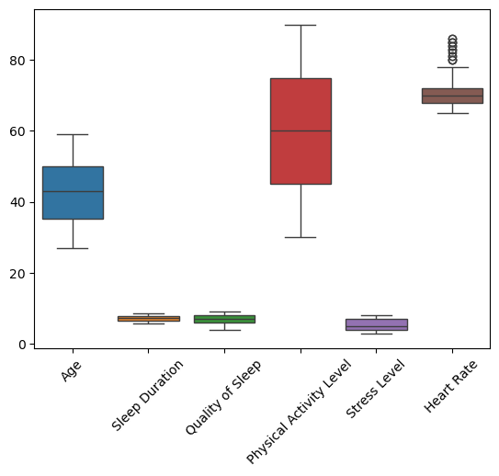
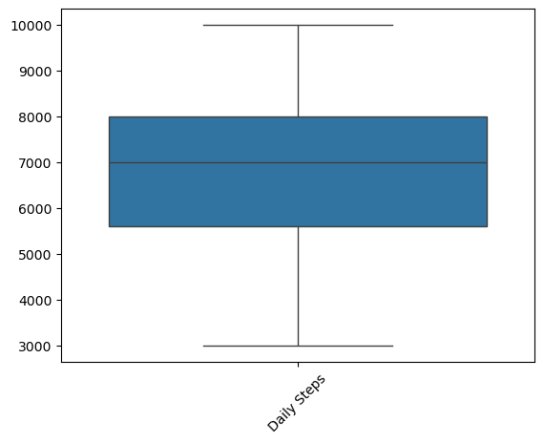
Outlier Analysis
We have detected only few ouliers but have not treated them as we are understanding the
influence on the target

Slide 13
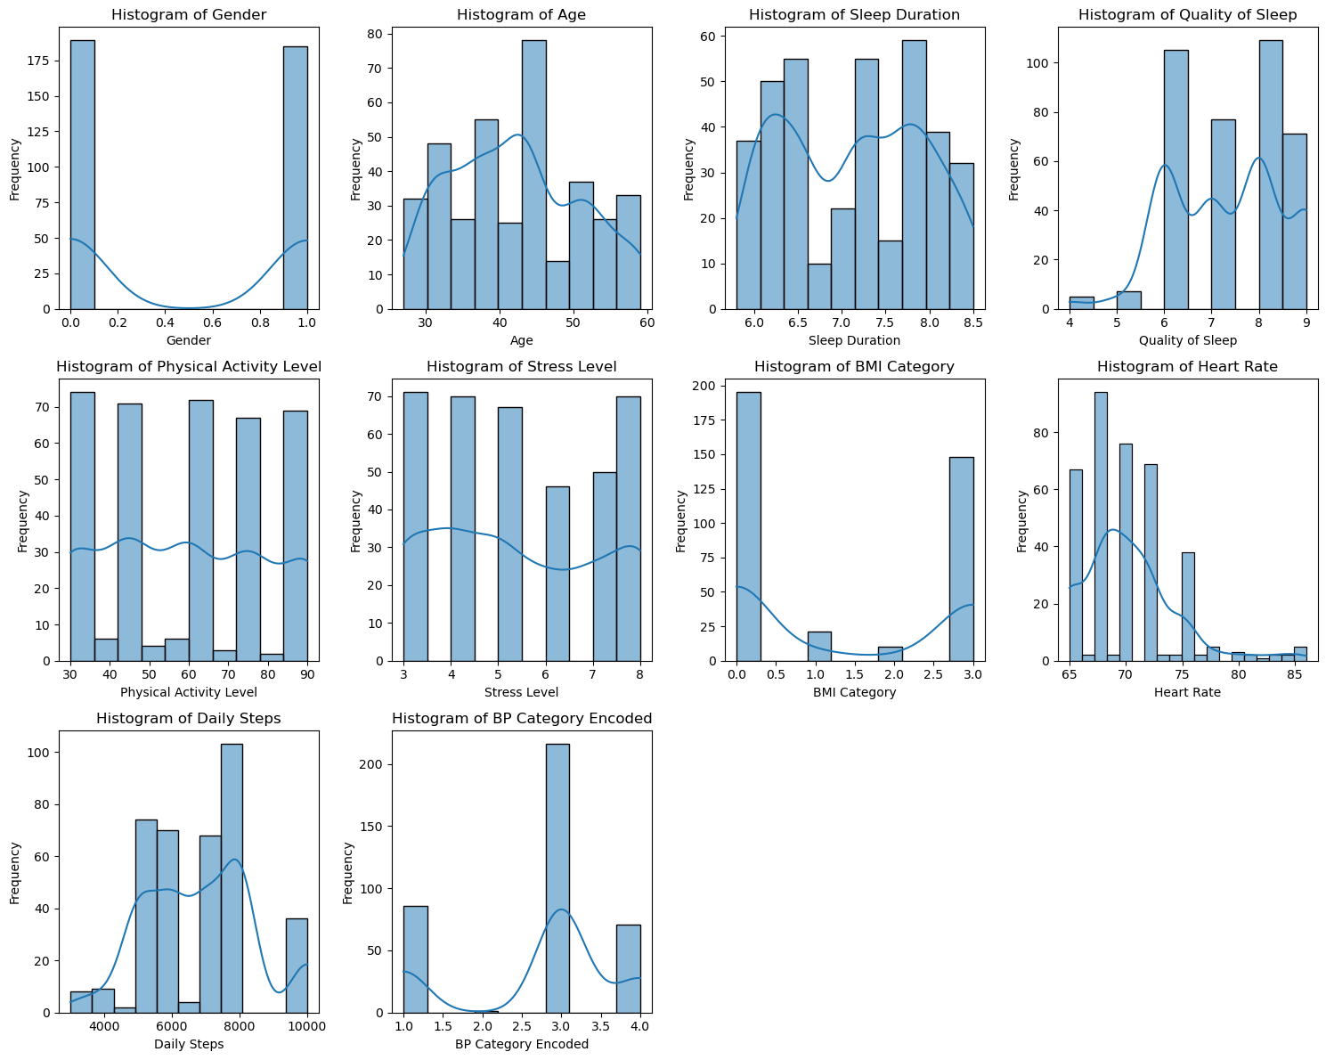
Univariate Analysis

Slide 14
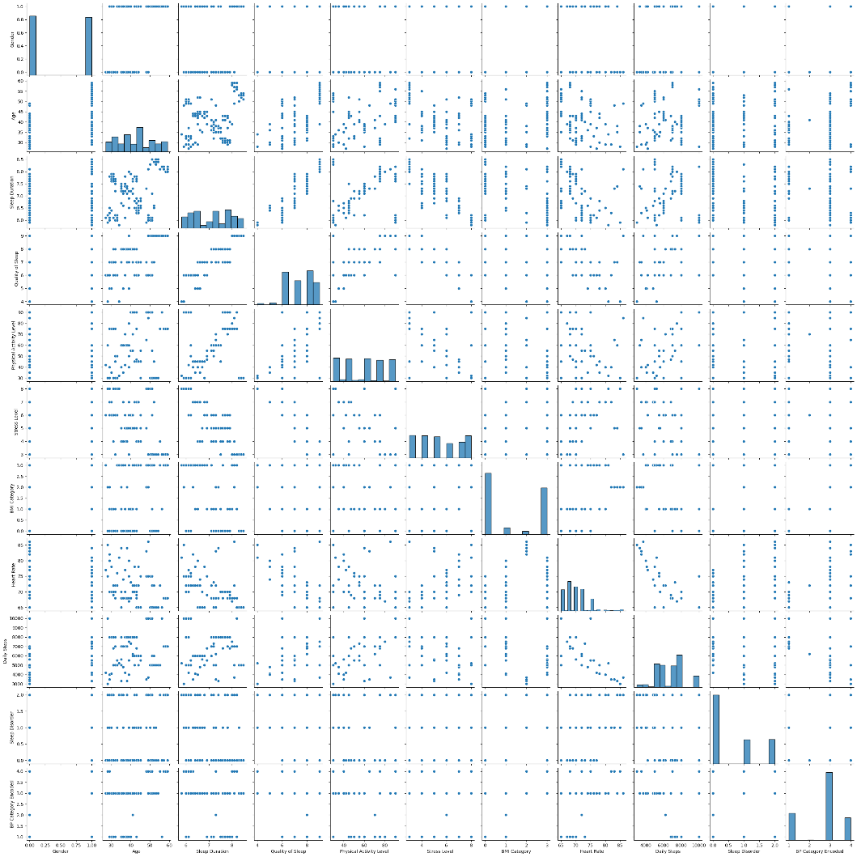
Bivariate Analysis (pair-plot)

Slide 15
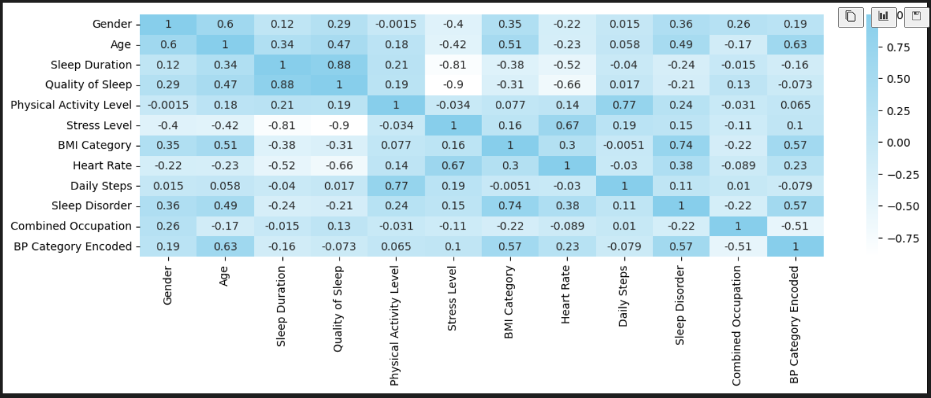
Correlation between features and the target

Slide 16
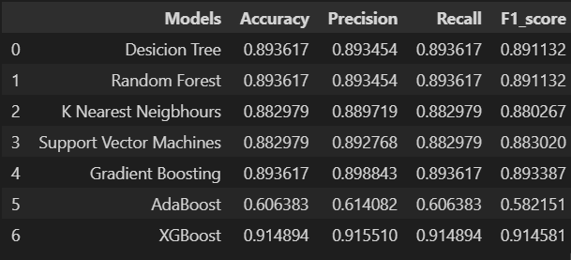
Model Training and Evaluating
The dataset is trained with all the above mentioned models (Usually vanilla models) and the evaluation metrics are used to check the performance.

Slide 17
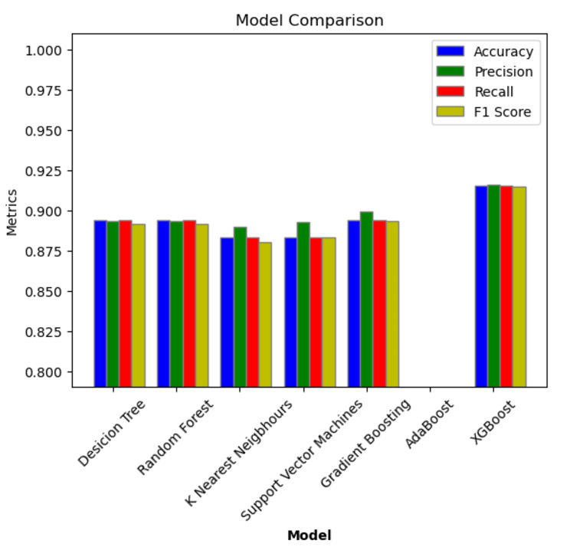
Comparing Model Performance

Slide 18
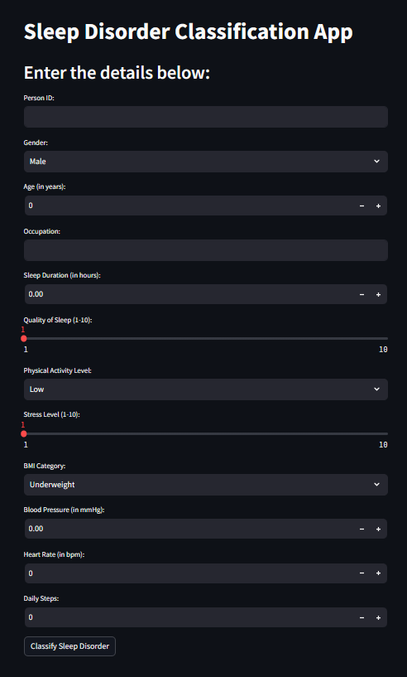
Deployment using Streamlit

Slide 19
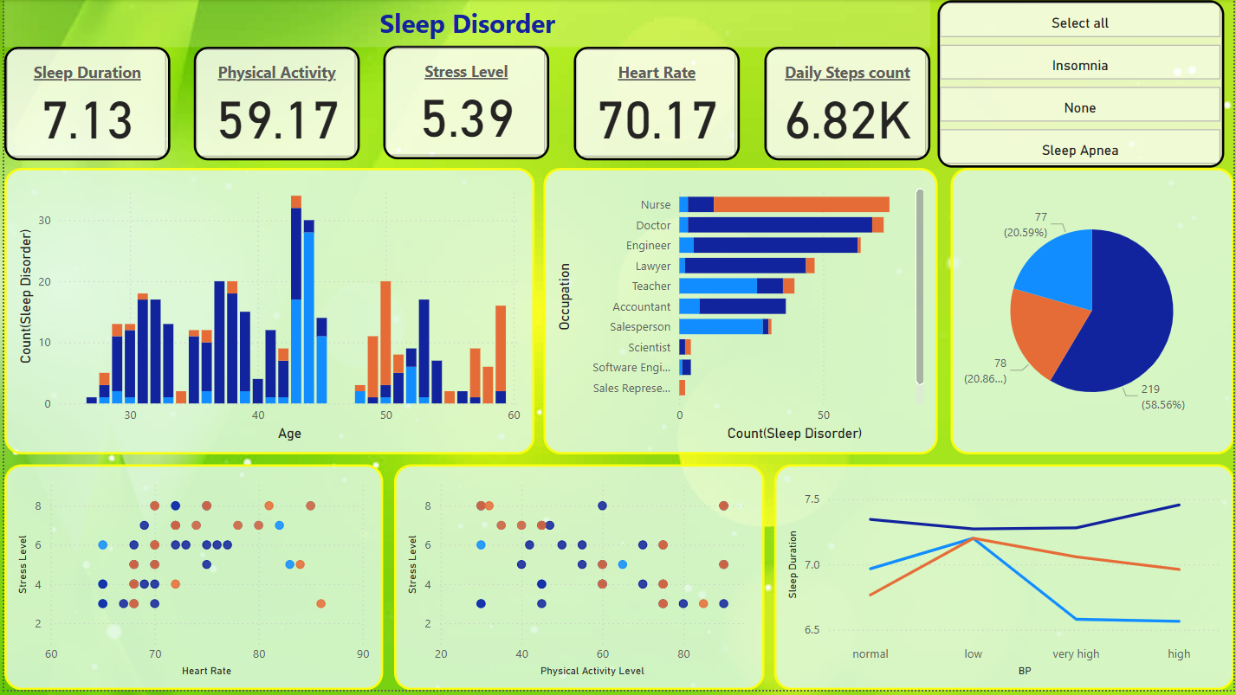
Dashboard Using Power BI Page 1

Slide 20
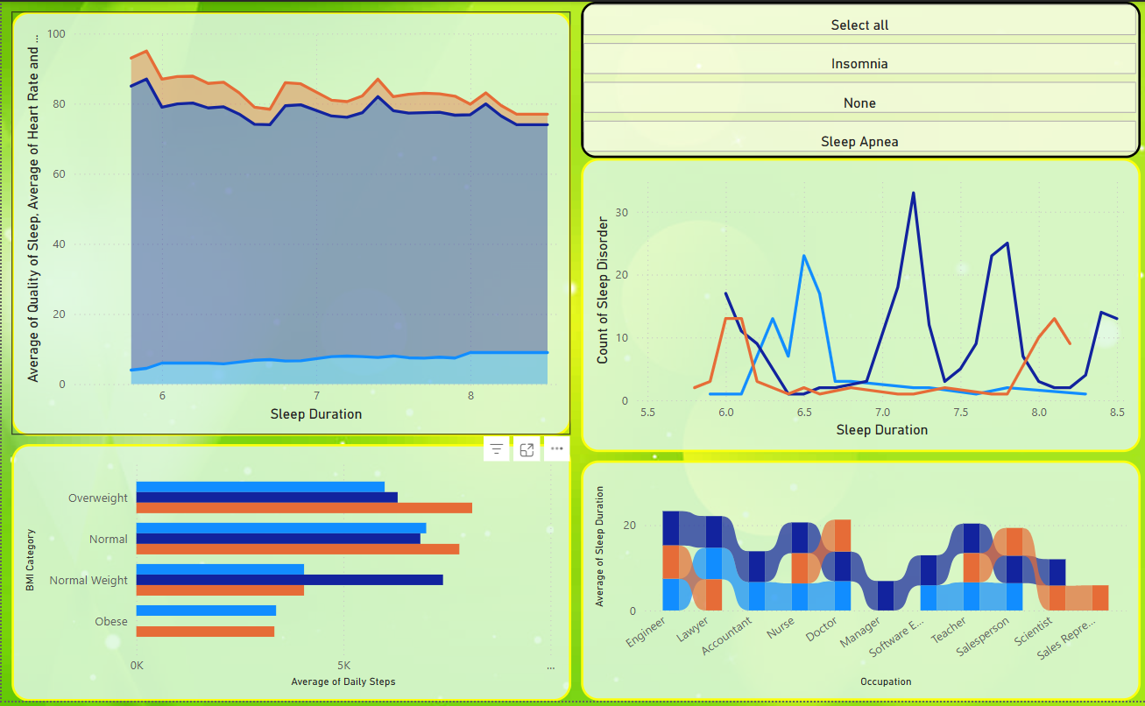
Dashboard Using Power BI Page 2

Slide 21
Project Link
I have created a GitHub repository for the project explaining all the details.
predict-Sleep-Disorder/SleepDisorderPrediction.ipynb at main · NavyaSai-V/predict-Sleep-Disorder

Slide 22
Questions ?
Navya Sai Arcot
navyasai1401@gmail.com

Slide 23
Thank You!
Navya Sai Arcot
navyasai1401@gmail.com

